Slide 1
Step into Care A Pathway into Social Care Employment
Sue Wright- GM Employability Project Manager
Jo Finnerty – Programme Manager Adult Social Care Workforce

Slide 2
Housekeeping
Greater Manchester Virtual Workforce Summit
GM Workforce summit 2020
Keep your camera on​ where possible.
And your mic on mute to avoid feedback.​
Use the chat function to share thoughts/feedback throughout the session, leave contact details if you would like us to get in touch!
This session is being recorded
Time for questions at the end - Raise your hand (function top right of the screen) if you would like to contribute.
#GMwfsummit2020
#Doingthingsdifferentlyforourworkforce

Slide 3
Setting the Scene
Challenges in social care
High turnover of staff
High level of vacancies
Older workforce and succession challenges
Drive for values based recruitment
‘Grow our own’ approach
Employability
Ageing population
Staff Shortage
New people – new ideas
This has led us to look at developing a sector-based work academy/ Pre-employment programme for adult social care

Slide 4
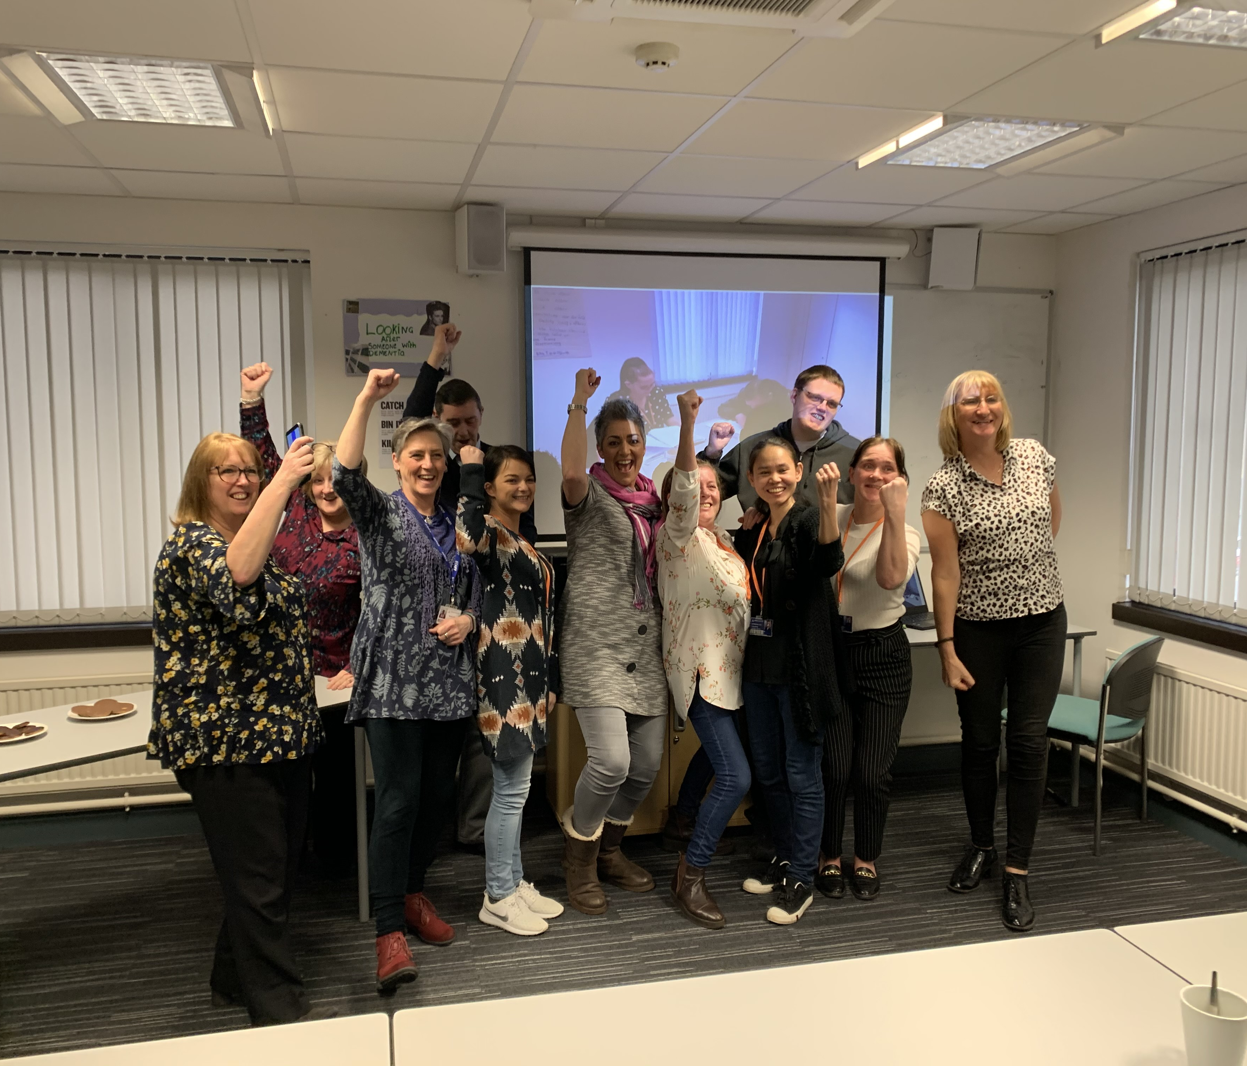
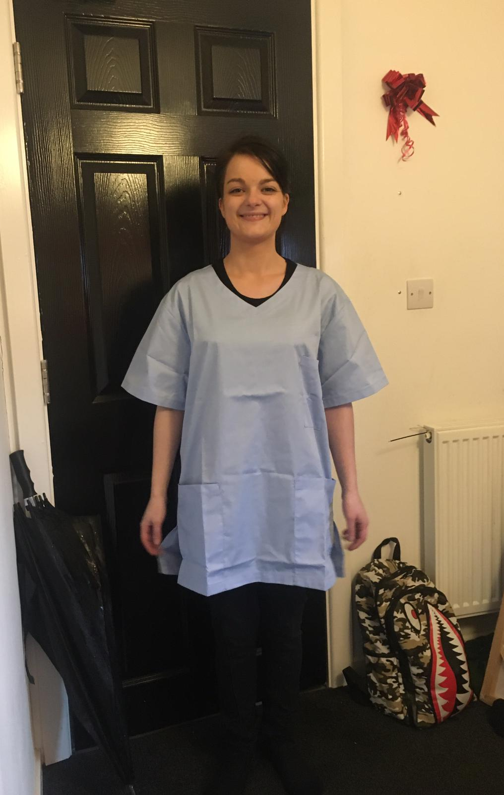
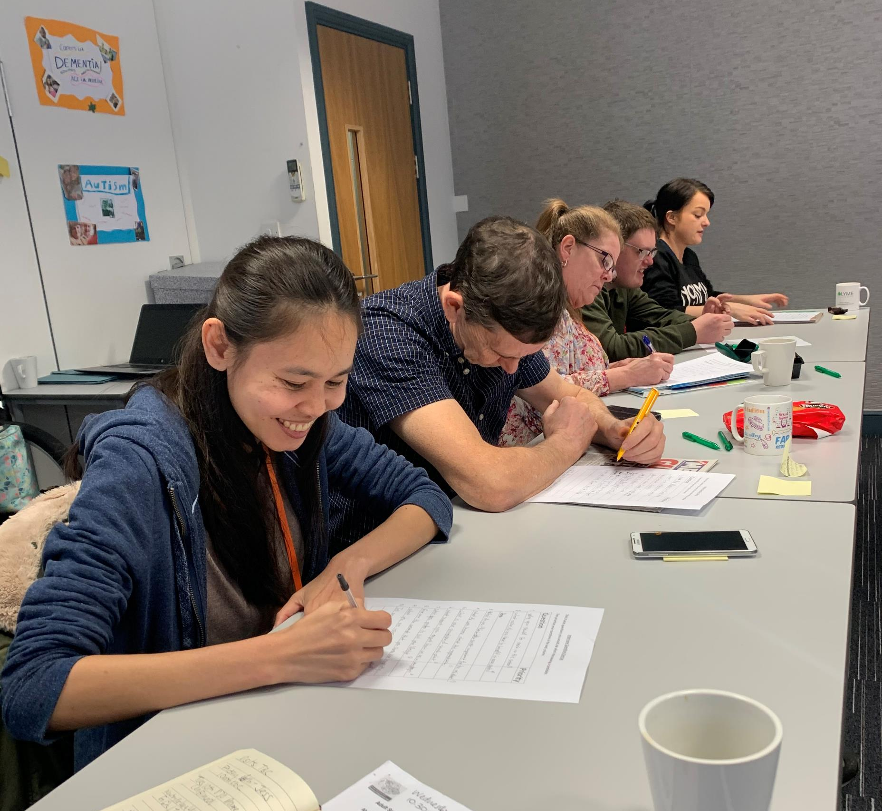
Pilot Programme January 2020
Step into Work HEE
Sector Based Work Academy in partnership with Salford City College
GM Programme – Location
4 weeks college
1 week employer workshops
4 weeks placement
Covid-19 struck

Slide 5
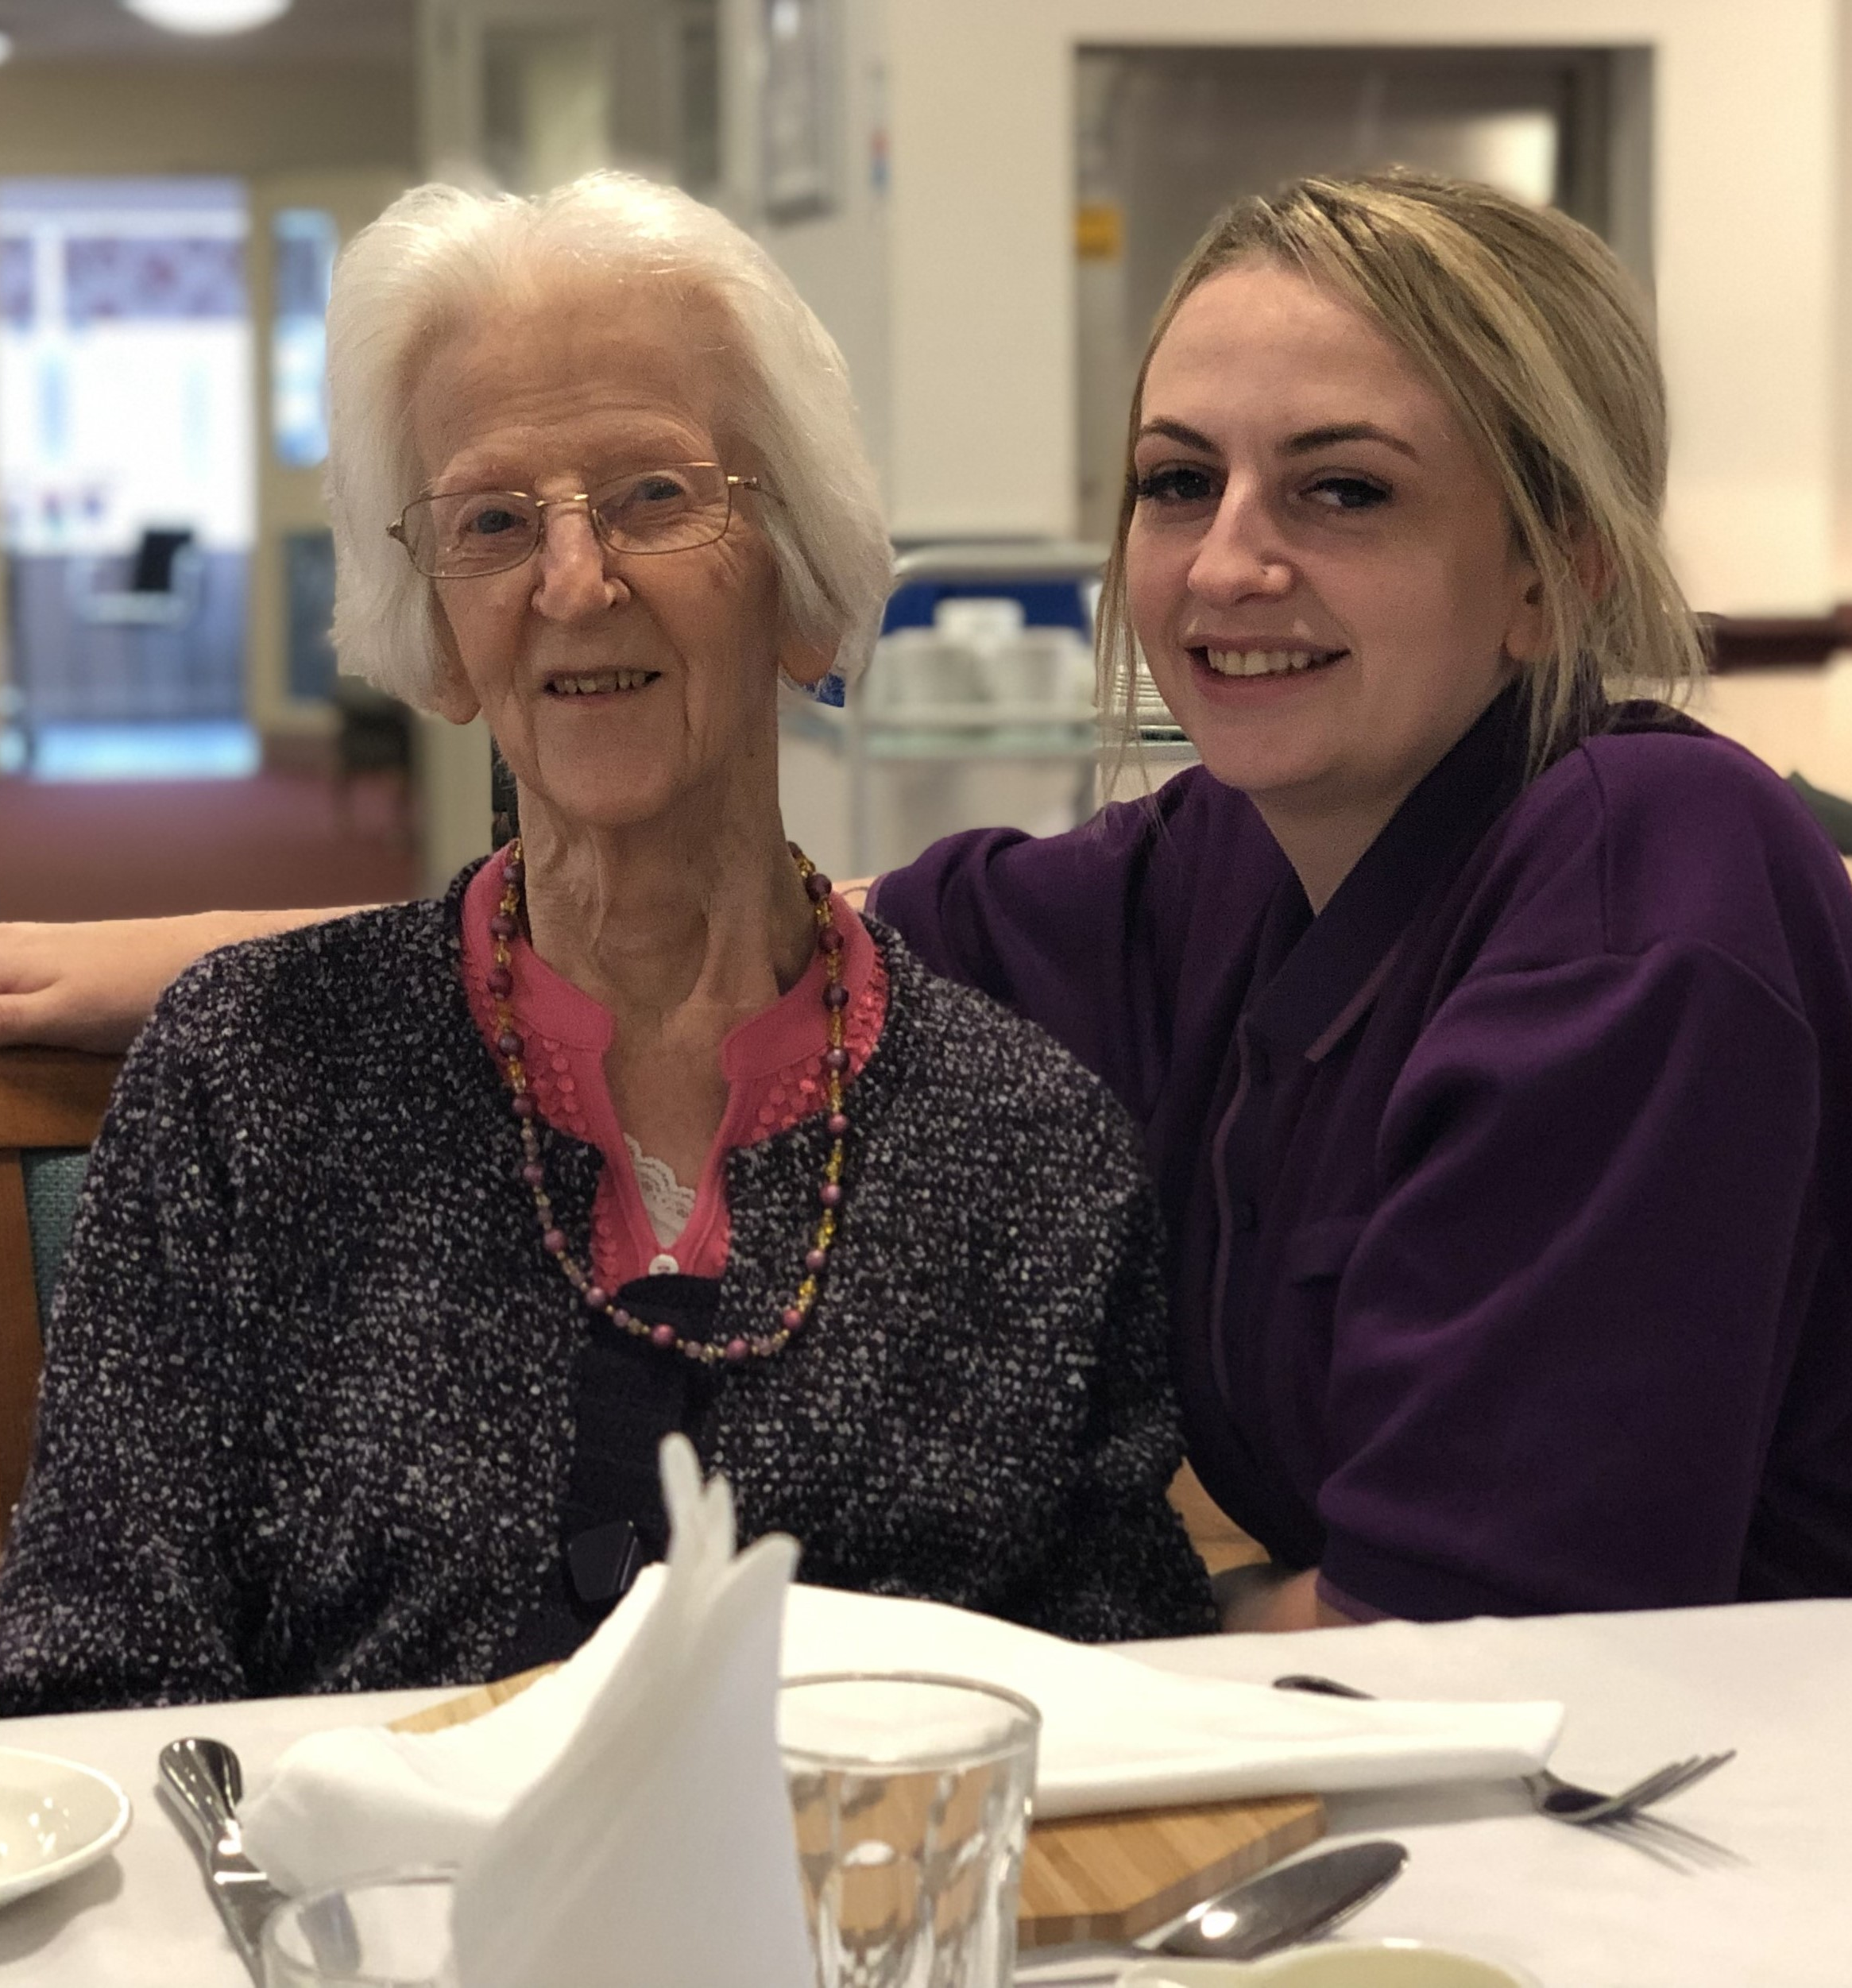
Why did we put the Step into Care programme in place
Covid-19 Crisis
Lockdown
Support providers in recruiting to essential support roles
Support local communities across GM furthest away from the job market
Support people impacted by Covid-19
ASC Transformation programme

Slide 6
What did our GM Providers tell us they needed?
Engaged with providers to understand what might support them
Supported Living – reduced staff numbers
Care homes –current vacancies ongoing, absences, staff shortage
Areas with fewer team members (catering, laundry)
Needed applicants asap / values based
Training to support initial placement and save managers time upon recruitment
Shorter placement

Slide 7
Shorter Placement
We needed to carefully balance sufficient training to ensure people have an introduction into the care sector, as well as initial skills and confidence
Source applicants in a timely manner to support GM services
Employers are able to recruit into the team faster , to continue training and multi skilling new recruits
Employees are in employment quicker and earning a living

Slide 8
Working in Collaboration
GM Health and Social Care Careers Hub
GMHSCP
The WEA (a voluntary sector adult learning provider)
Supported by DWP and Skills for Care
A fully funded entry level work-based education programme aimed at people currently out of work or education and interested in pursuing a career in Social Care
Support roles – care, catering, domestic, housekeeping, laundry, admin roles
Training delivered via an online platform

Slide 9
Supporting more services
Currently now working with care homes and supported living services
Working with Brokerage Organisations to support recruitment of personal assistants
Home Care – Piloting this with Wigan Council/ Providers within the Ethical Framework

Slide 10
Eligibility
19+
Actively seeking work in adult social care
Resident in the UK for 6 months
Eligible to work in the UK

Slide 11
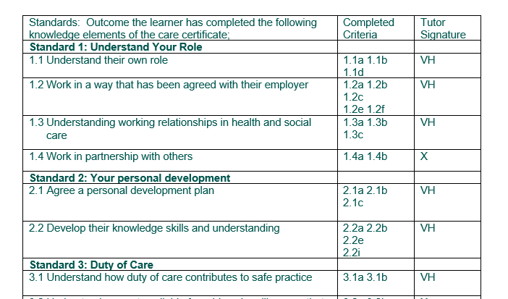
What does the programme involve?
Learners enrol onto a 6 week education programme
Online distance learning with WEA
Knowledge elements of the care certificate
NCFE L1 Mental Health Awareness
NCFE L1 Stress Awareness
Employability skills
The outcomes and scheme of work conform to the mapping standards provided by Skills for Care so that each learner can build a portfolio towards their future qualifications.

Slide 12
Initial Assessments and Enrolment
Initial Assessments are completed to assess suitability
Understanding of the course
Support available for learners not quite work ready
DBS check- Covid -19
Adult First Check in place
Risk assessed and shadowed throughout placement
Funded DBS once Covid -19 option ends

Slide 13
Delivery of training
Zoom sessions
Videos/presentations
Breakout discussion groups Assessment activities
Access to Canvas Learning Platform
Links and resources
40 hours of guided learning
Additional 10 hours to include tutorial time and one to one support

Slide 14
Values based Application and Interview
Learners complete an values based application form to be considered for a social care placement
All placements have a current vacancy
Zoom Interviews planned – very much values based
Area of work/hours/travel
Providers across GM Fixed term and permanent contract options

Slide 15
Voluntary Placement planned
24 hours in total
2x 12 hour shift
4 x 8 hour shifts
Learner experiences the social care environment
Recruiting Manager can access suitability
Ultimate goal – Recruit to vacancies within the local community

Slide 16
Partnership Working – Potential Applicants referred
Weekly vacancy update – JCP
Areas targeted to gain referrals
Regular Team meetings with Job Coaches and Employer Advisors across GM
Referrals via JEWEL, Volunteer Service, carer groups, Growth Company, GM Housing Associations
online promotion
LinkedIn
Virtual Open Day now in place

Slide 17
Vacancies in Home Care
Home Care much needed especially now
So many opportunities and vacancies
Continuously asked about supporting home care providers
Traditional home care arrangement require people to use cars to travel across a large area, visiting a number of clients throughout the day
Proves to be challenging in terms of recruiting new entrants into social care
Wigan Ethical Framework have shown us another effective way…

Slide 18
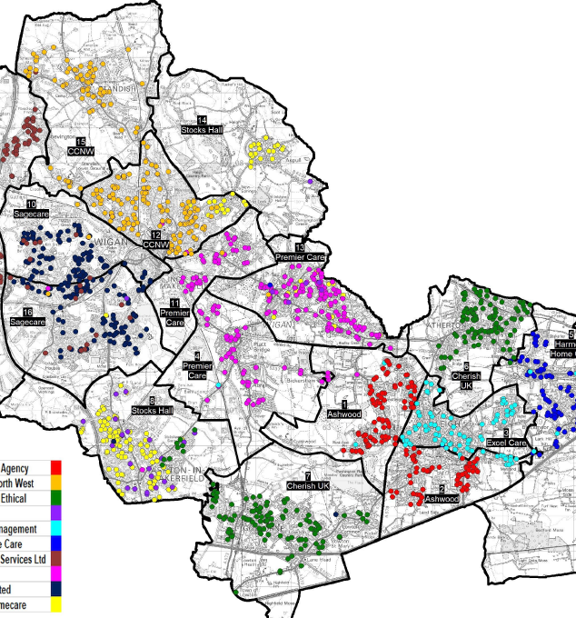
Wigan Ethical Frame Work
Cathy and Carol – Wigan JCP
Wigan Council
10 providers
Work together
Standards to meet -
Set areas
Positive workforce
Shared training days
Walking rounds
Watch this space…

Slide 19
Challenges
Providers time
Early leavers
Online training
Delivering programme whilst still planning
RM Meetings and engagement
Unemployed number
Each organisation recruits slightly differently
Public transport
Syncing vacancies with applicants

Slide 20
Positives
Massively supported social care during a difficult time
Students engage well via online platforms and WhatsApp Groups
No venue to source for training – GM wide
Quicker turn around into employment
Providers prefer the shorter placement
Outcomes have been positive

Slide 21
Outcomes to date – May to November
87.5 positive employment offers
2.5% were not offered employment
10% decided a role in care wasn’t for them
Programme 5 - 9 Live placements currently taking place across GM this week
Programme 6 - 30 Potential applicants enrolled this week onto the training programme

Slide 22
Feedback - learners
I was able to find employment in a fabulous care setting. I am now able to come off benefits and go back to work thus having minimal impact on my mental wellbeing.
Completing the programme has changed everything massively, it has enabled me to pursue the career that I wanted to due to changing my mind about engineering, it has opened up many paths on which I could choose which is an amazing position to be in.
I've now got my dream job I'm happy I'm settled I see a bright future this really had impacted my family in an amazing way

Slide 23
Emily - Oldham
Emily
Single parent
Aspiring to be a paramedic
No self belief
Fantastic feedback

Slide 24
Wayne - Salford
Wayne
Tram driver
Redundant due to Covid
Thought his age was against him

Slide 25
Provider feedback
PossAbilities

Slide 26
Feedback - Providers
We were able to provide information in regards to what we required from the candidate. The GM Employability Manager worked closely with us and knew exactly what we needed.
Helped with time constraints because all screening, interviews, part induction training and recruitment checks were done through this programme.
The Step into Care programme is an excellent initiative and recruitment tool for employers, and I strongly recommend Sue and her team.

Slide 27
Session summary and questions
Please add your thoughts and feedback in the chat box
If you are interested in working with us please leave your contact details in the chat function
Thanks for joining us today
Any questions, please raise your virtual hand?

