Slide 1
Developing a GM AHPs Leadership Framework
Rachel Hemingway
Assistant Director of AHPs
Bolton NHS Foundation Trust

Slide 2
JamBoard

Slide 4
“Leadership for AHPs across the organisation is patchy and relies heavily on senior positions which are all part-time. It also relies on having a director of nursing and professions who has an understanding of AHPs, as there is no direct route to the board. The need for AHP leadership is not well understood nor is the need for representation of AHPs in operational matters.”
‘Leadership of allied health professions in trusts: what exists, what matters’

Slide 5
Why?
3rd largest NHS workforce
National agenda
Build on the AHP identity
Regional agenda
New leadership roles
Grow our own GM leaders
Excellent system leader skills

Slide 6
National context: AHPs into Action Framework
Priority One:
AHPs
can lead
change

Slide 7
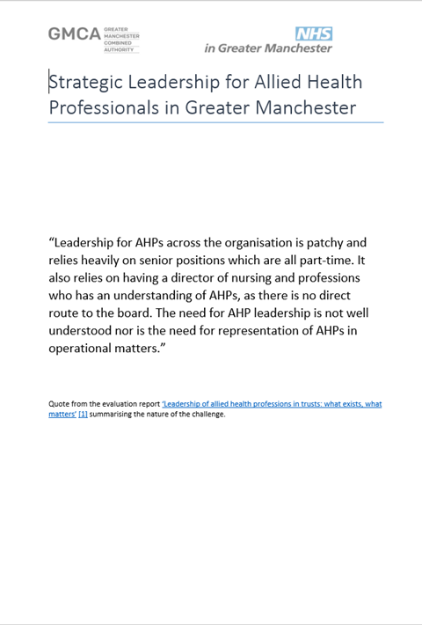

Slide 8
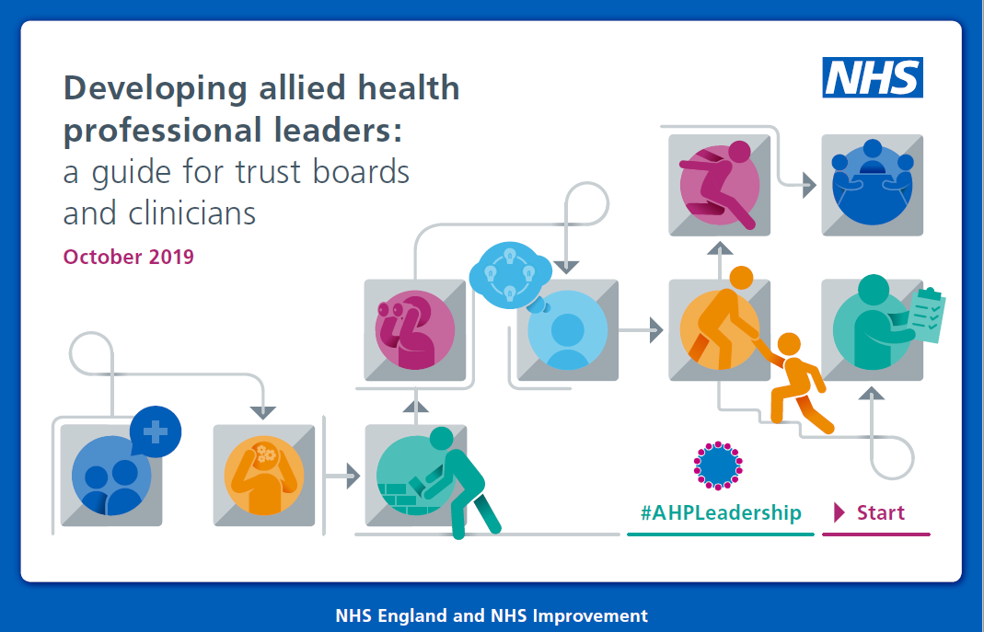

Slide 9
Our People promise
Our People Plan for
Greater Manchester
Our people promise
Our People Promise

Slide 10
Strategic Leadership for Allied Health Professionals in Greater Manchester
Summary of Recommendations
NHS Trusts and statutory provider organisations in GM should strengthen their AHP leadership structures by appointing a Chief AHP with a substantive strategic focus.
The GM AHP Council should develop strong links with AHP Leaders in GM organisations and facilitate effective communication through organisations.
The GM AHP Council, working with NHS Improvement, should offer support and guidance to organisations looking to develop AHP strategic leadership positions.
The GM AHP Council should publish annually the current AHP Leadership profile in GM.

Slide 11
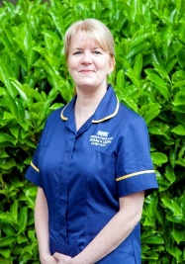
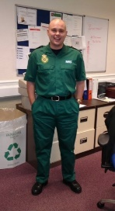
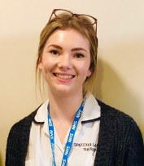
GM AHPs Leadership Profiles
Lesley Hadley | Chief AHP | WWL NHS FT
Believe in yourself – AHP’s are great and have loads of transferrable skills
Be brave - moving out of your comfort zone can provide invaluable exposure & experience
Work/life balance is key – never apologise for making the right decision for you and your family
Paul Howard | Director of Corporate Affairs | WWL NHS FT
Never be afraid to ask for help, and once you are established in your role never forget what it was like to be a new starter
A well-written report to a board or committee meeting is worth its weight in gold – spend time getting the content right and you won’t have tons of questions to answer. It will also make you and your team stand out for the right reasons.
Don’t be defined by your background, use this to add value to the role that you want to undertake
Sophie Chalmers | AHP Clinical Academic Researcher | Bolton NHS FT
Make friends and nurture professional relationships
Start small and build confidence
Build a track record
Steve Brown | Senior Specialist OT | MFT NHS FT |
Clinical Lead OT | NHS Nightingale NW
Naheed Ahmed | Major Trauma Physiotherapist | MFT NHS FT
Egos can be destructive to teamwork and leadership: try and leave them at the door.
Reflect and consolidate what you have learned before trying to develop further.
Leadership is not just a role for managers or senior staff; try not to let a hierarchical environment stifle your passion.
Practise what you preach
Empower staff
Enjoy what you do

Slide 12
GM AHP Lead
Lesley Hadley
Chief AHP
Wrightington, Wigan and Leigh NHS Foundation Trust

Slide 13
Pre-requisite conditions for leadership growth
Culture
Time
Money
Consistent fair use across and within organisations
Collaborative approach

Slide 14
Clinical Leadership: a Framework for action January 2019

Slide 15
JamBoard

Slide 17
JamBoard

