Slide 1
GM Workforce Summit 2020
Being Comfortable with Chaos
Leading in a VUCA World

Slide 2
“Joy, built over time, fuels Resilience”
Brene Brown
Let’s Start!

Slide 3
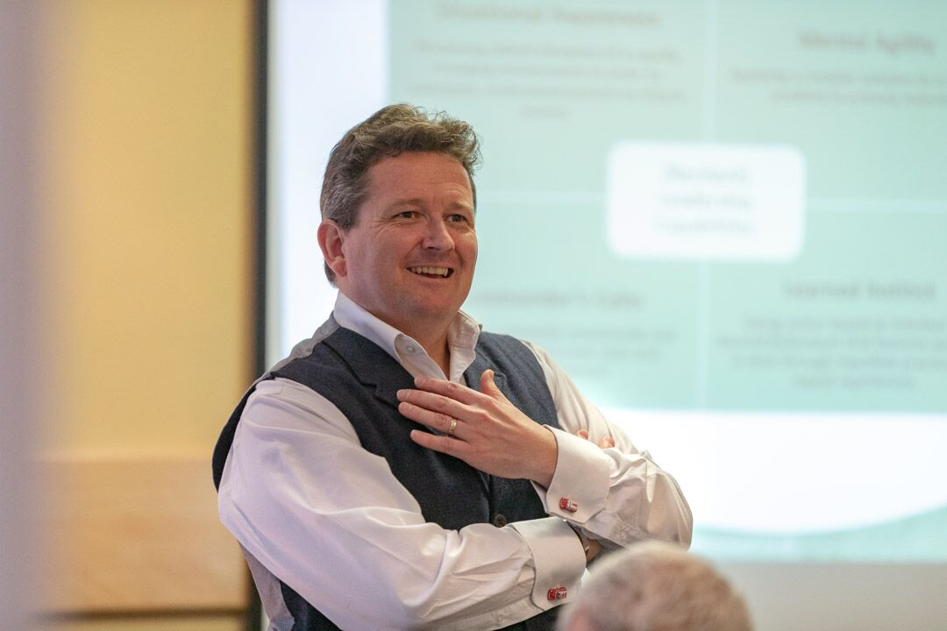
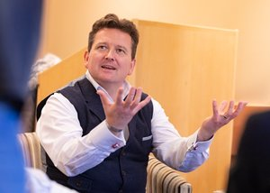
Who am I?!
Associate Consultant with
18 years within the field of Learning, Leadership and Organisational Development
9 years specialising around Resilience and VUCA

Slide 4
TRUSTED BY THESE COMPANIES

Slide 5
“The illiterate of the 21st Century will not be those that cannot read and write, but those that cannot learn, unlearn and relearn.”
Alvin Toffler
Aims for this session

Slide 6
OUTCOMES
Provide an overview of VUCA and VUCA Prime
Clarify the Leadership Capabilities that support leading in uncertain times
Specify and Self-Assess yourselves against the Peak Performance Skills
Consider your own next steps and actions

Slide 7
Which represents you?
I’ve never heard of VUCA and am eager to learn more.
I’ve heard of VUCA and have some basic understanding and think I might be using some of the relevant skills and capabilities.
I’m fed up with hearing about VUCA! Isn’t it just Common Sense – we’re in a crazy world.
What’s the fuss all about, it’s the same as it’s always been.

Slide 8
“It is better to be a Pirate than to join the Army.”
Steve Jobs
Disruption is “the norm”?

Slide 9
Our Global Context
“What’s happening!?!?!?”
Volatile
Uncertain
Complex
Ambiguous
The speed, rate and rapidity of change
Unclear about the here and now and impact/effect – law of unintended consequences
Multiple key decision factors
Lack of clarity about meaning of events – no “right answer”

Slide 10
Our Global Context
VUCA Prime - “Solution(s)”
Vision
Understanding
Clarity
Agility
Situational awareness, foresight
I am comfortable feeling uncomfortable
Discovering boundaries – “what am I working within”
Decide a course of action, be ready to change course

Slide 11
Reflections/So What?/Bothered!?

Slide 12
“One of the greatest problems we face today is how to adjust our way of thinking to meet the challenge, of an increasingly complex, rapidly changing, unpredictable world. We must rethink our way of organising knowledge.”
Edgar Morin, French Philosopher and Complexity Theorist
www.theresiliencecoach.co.uk
www.theresiliencecoach.co.uk

Slide 13
“I resolve a suite of dilemma’s
ethically and creatively”

Slide 14
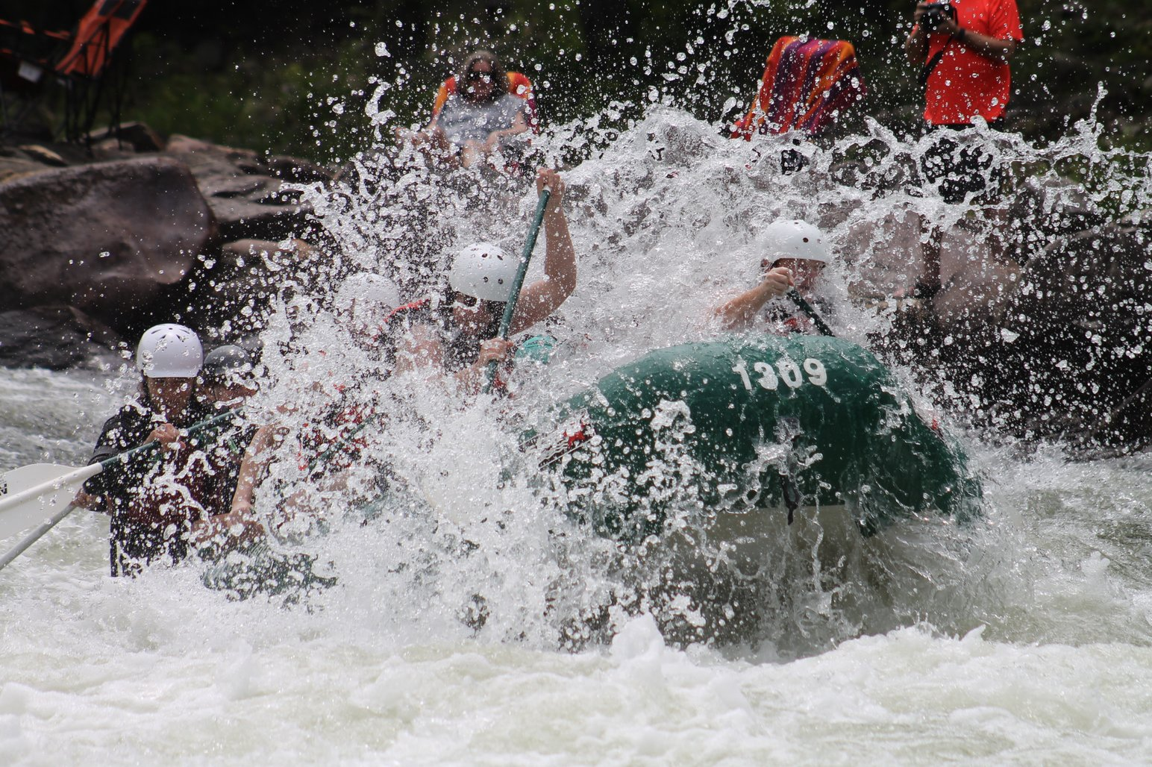
VUCA Leadership Capabilities
www.theresiliencecoach.co.uk
www.theresiliencecoach.co.uk

Slide 15
(Resilient) Leadership Capabilities
Situational Awareness
Perceiving salient elements of a rapidly changing environment in order to anticipate, understand and act on future events.
Mental Agility
Applying a creative solution to a complex problem in a timely manner.
Commander’s Calm
Responding mentally, emotionally and physiologically in a cool, calm and composed manner.
Learned Instinct
Taking action based on intuition and learned behaviours that become automatic in time through repetitive practice and repeat experiences.

Slide 16
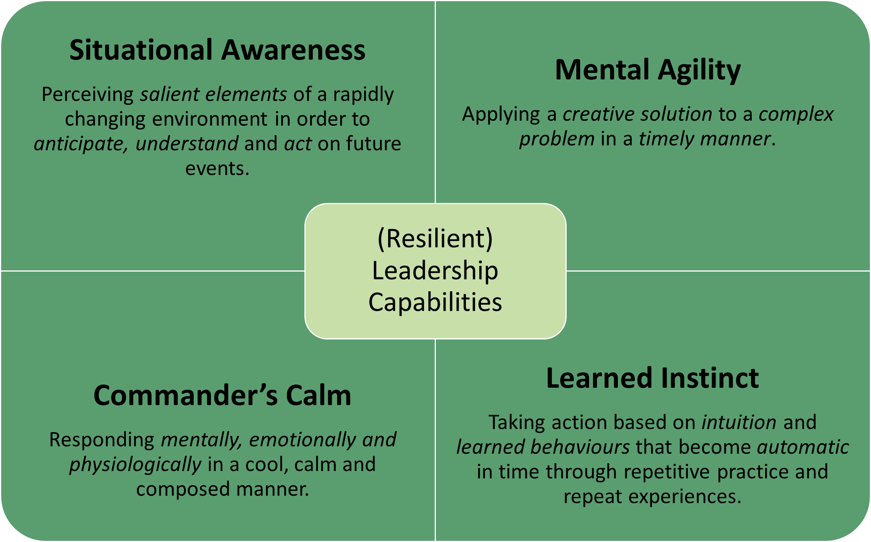
Which Leadership Capabilities energise you?
Situational Awareness
Mental Agility
Commander’s Calm
Learned Instinct

Slide 17
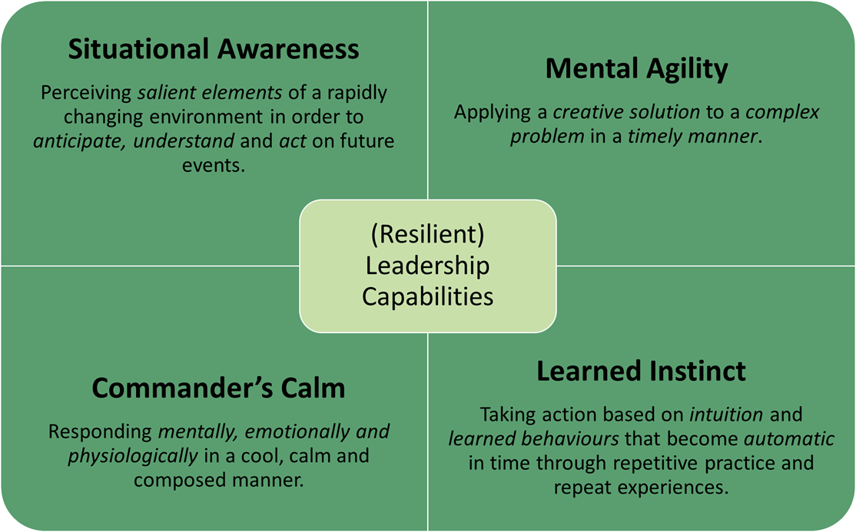
Breakout
Discuss the 4 Leadership Capabilities and:
(15 minutes in total)
Specify 2-3 ideas for making improvements in each Capability

Slide 18
Time to share

Slide 19
Situational Awareness | Mental Agility | Commander’s Calm | Learned Instinct

Slide 20
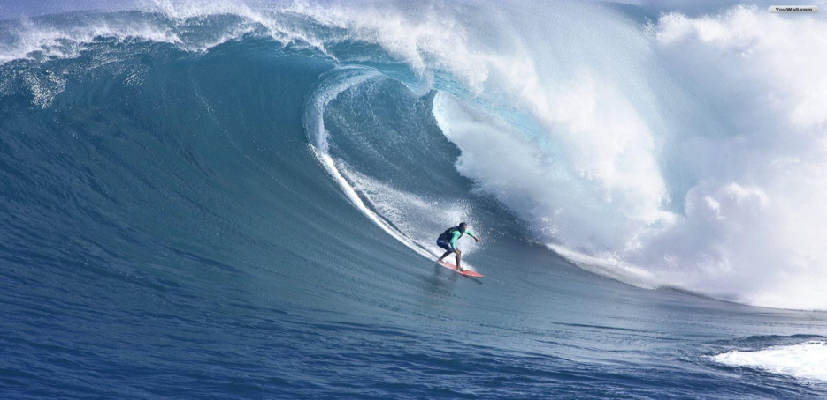
Dr Louis Csoka
“The ability to perform at one’s best in extreme conditions comes from a combination of confidence, positive and adaptive thinking, a sense of calm and composure under fire, exceptional focus and concentration and the ability to envision success before it happens.”
www.theresiliencecoach.co.uk

Slide 21
“I resolve a suite of dilemma’s
ethically and creatively”

Slide 22
The Peak Performance Skills
www.theresiliencecoach.co.uk
www.theresiliencecoach.co.uk

Slide 23
Peak Performance Skills
Adaptive Thinking
Stress Management
(Mindfulness)
Attention Control
Visualisation and Imagery
Goal-setting

Slide 24
The Peak Performance Skills
Goal Setting – clear purpose, write down & regularly review and assess
Adaptive Thinking – I know the mindset I need to preform well & actually do it
Stress Management – tuned into my body & mind & know & actually do the things required to de-stress
Attention Control - no multi-tasking! I focus my attention and manage distractions
Visualisation and Imagery – describe the end result with pictures, actually see it in my mind & enable others to do so

Slide 25
Goal Setting | Adaptive Thinking | Stress Management | Attention Control | Visualisation and Imagery

Slide 26
“When feeling safe and connected, people can release their innate genius for radical innovation.”
Dr Sunnie Giles
VUCA Leadership Tips

Slide 27
VUCA Leadership Tips
Different decision making
Empowerment
The team is the unit of delivery
Adapting
Tell & Share Stories
Agility
Foresight – Horizon Scanning
Clarifying boundaries

Slide 28
VUCA Leadership Tips
Clarifying boundaries – conversation about the few principles/outcomes you expect
Foresight – situational awareness – what’s coming down the line that could effect us?
Different decision making – resolve a suite of dilemma’s, ethically and creatively
Agility – knowing when to change course and direction and making the decision to do so
Tell, ask for and share Stories – Continuity, Novelty and Transition (next slide!)
Adapting – how you lead the team, your thinking, your decision making
Empowerment – your people know their role and know the right answers
The Team is the deliverer – get out of their way and remover their blockages

Slide 29
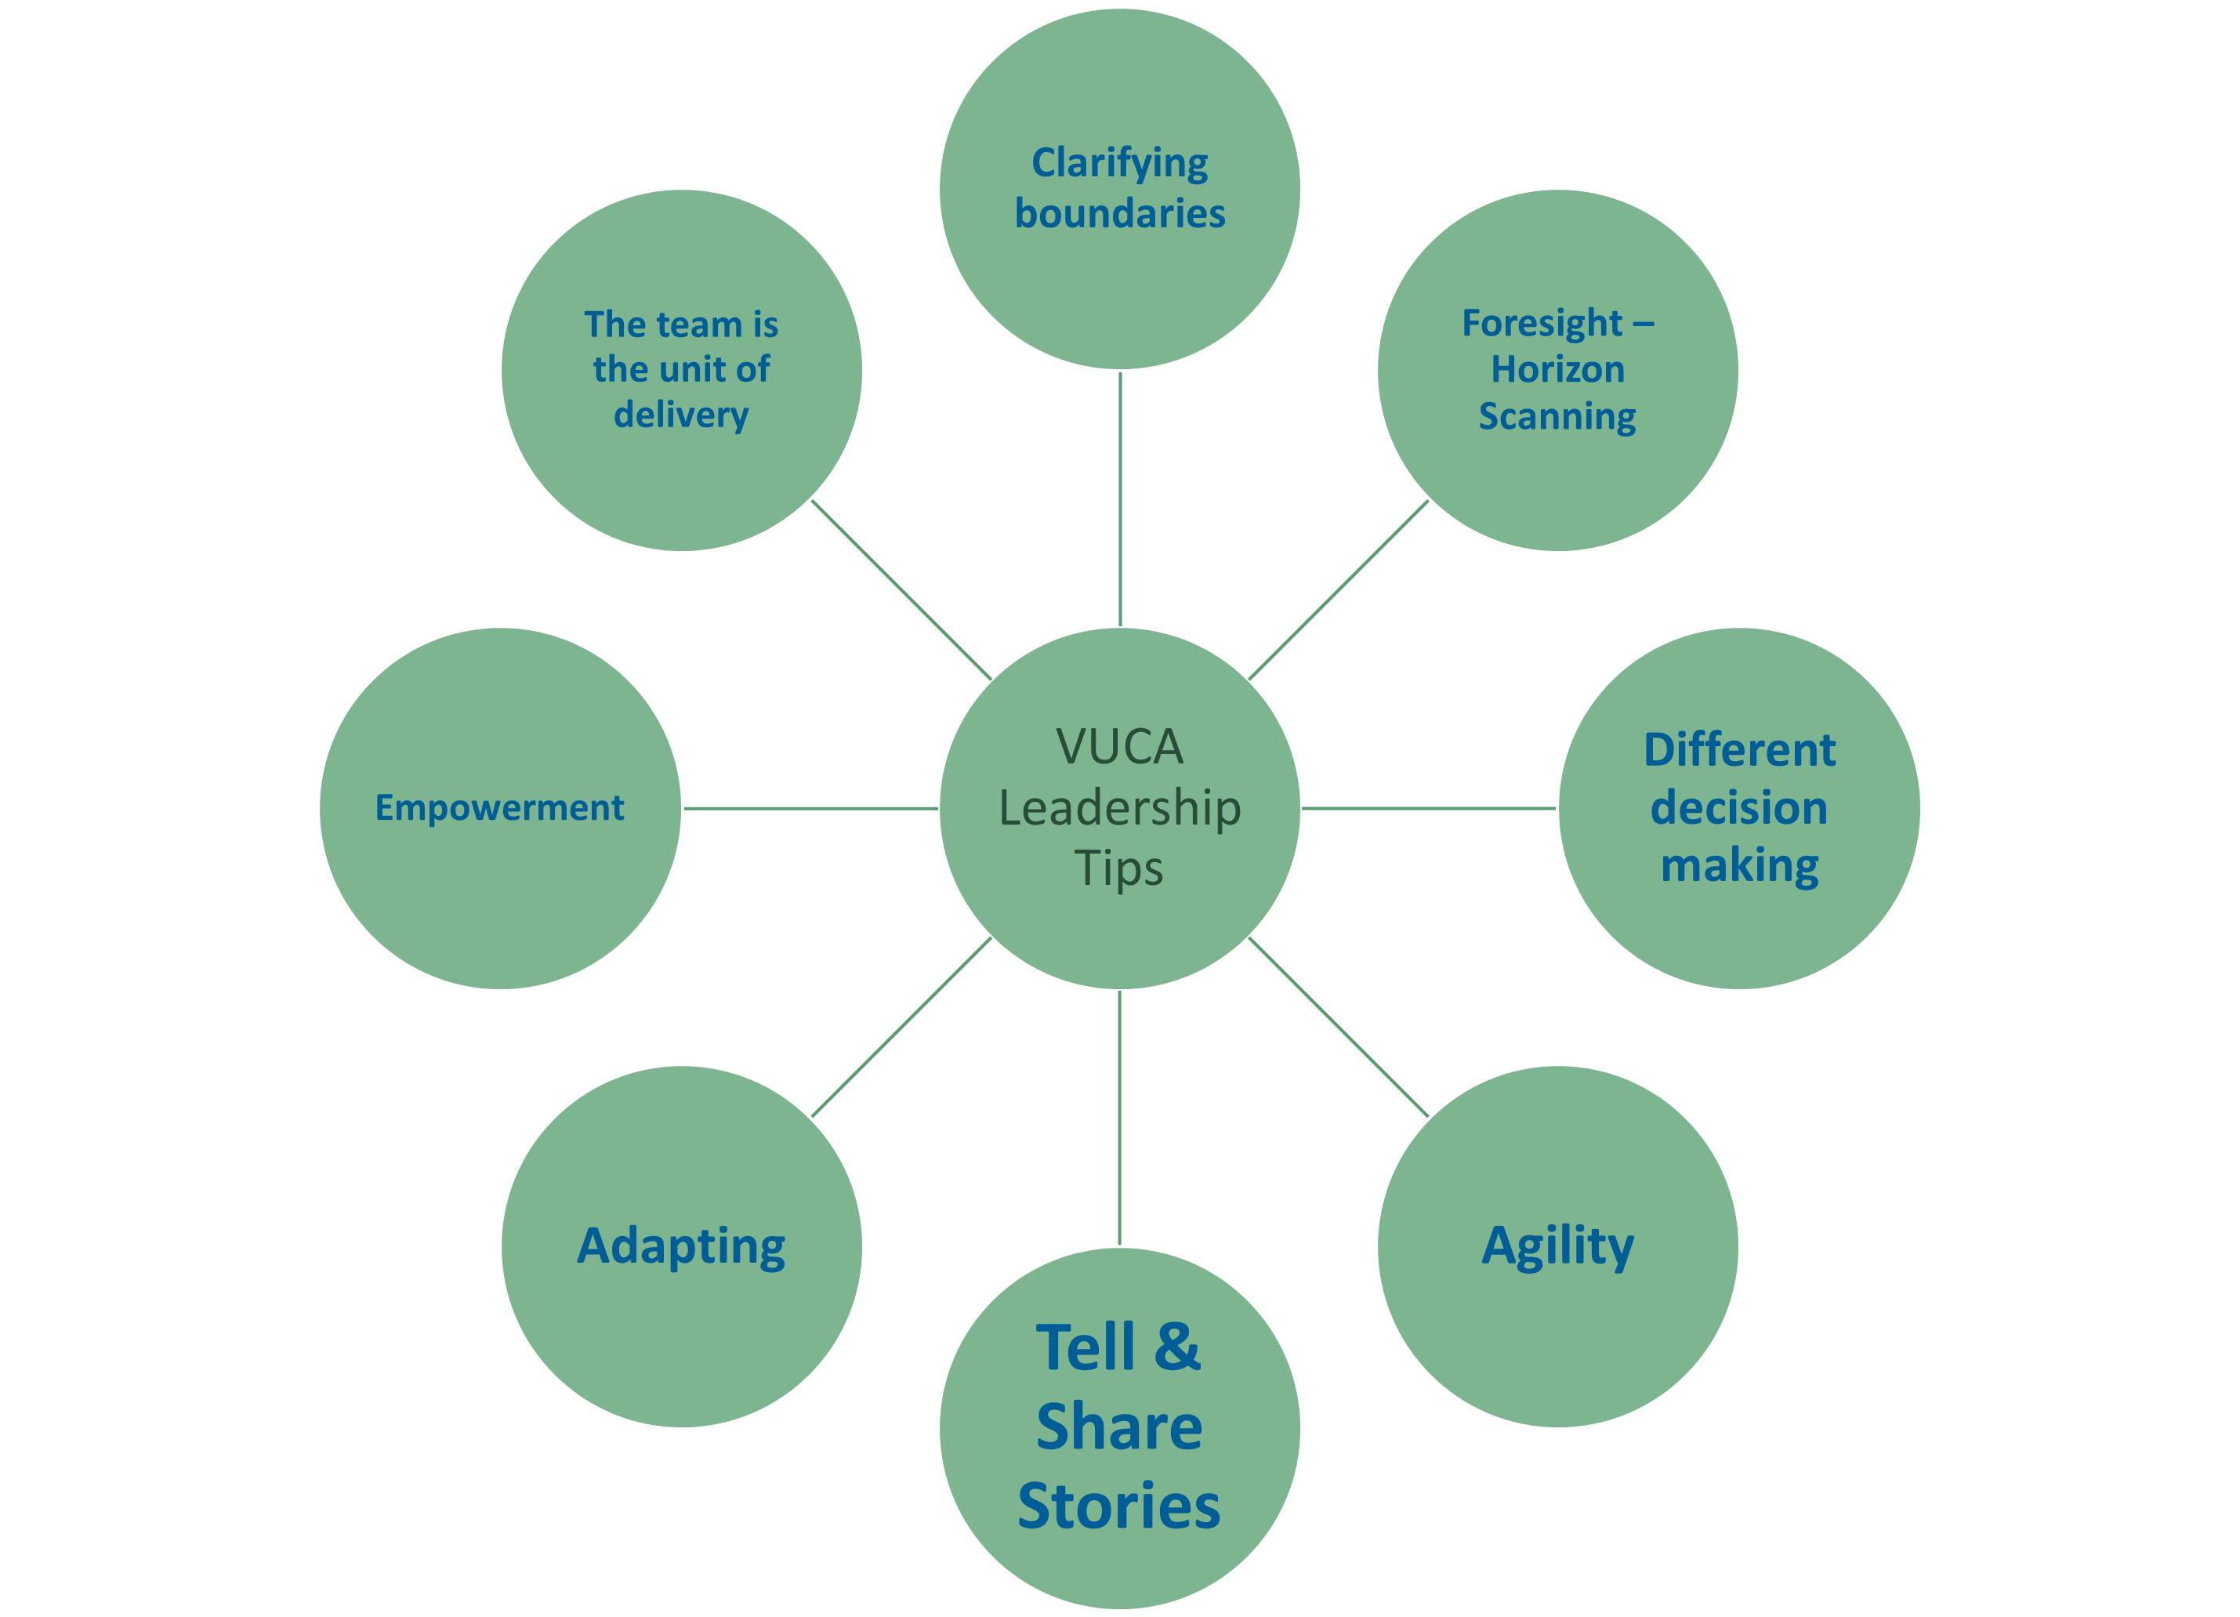
Which Leadership Tip are you going to do more of, first?

Slide 30
FEEDBACK
I’ve taken away lots that I can put into practice straight away
I’ve learnt some new tools and techniques and I will need to think about how I’m going to apply them
It’s been a helpful refresher
It’s been interesting and I’m not sure how I can apply it, at the moment

Slide 31
“Find the things that energise you, you love doing and are good at and do those as often as you can!”
Russell
Thank You!

